Slide 1
jQuery Fundamentals
Lesson 01

Slide 2
Lesson Objectives
jQuery Introduction
Why use jQuery?
Referencing a jQuery script
jQuery Versions
Using Content Delivery Network(CDN)
Using jQuery
jQuery Code Assistance
Notes:
Explain the lesson coverage

Slide 3
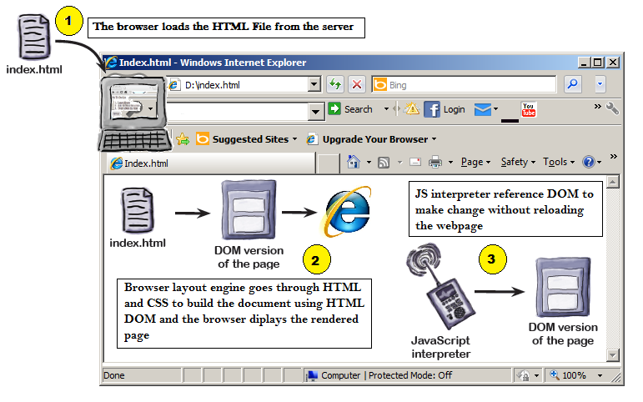
How webpage works
Notes:
Add the notes here.
Additional notes for instructor

Slide 4
jQuery Introduction
jQuery is a JavaScript library (single file)
It supports cross browser
Select HTML elements
Handle Events
Animate HTML elements
Make Ajax calls
1000’s of plug-ins available
Notes:
Additional notes for instructor

Slide 5
Why jQuery?
JavaScript is great for a lot of things especially manipulating the DOM but it’s pretty complex stuff. DOM manipulation is by no means straightforward at the base level, and that’s where jQuery comes in. It abstracts away a lot of the complexity involved in dealing with the DOM, and makes creating effects super easy.
It can locate elements with a specific class
It can apply styles to multiple elements
It solves the cross browser issues
It supports method chaining
It makes the client side development very easy
Notes:
Add the notes here.
Additional notes for instructor

Slide 6
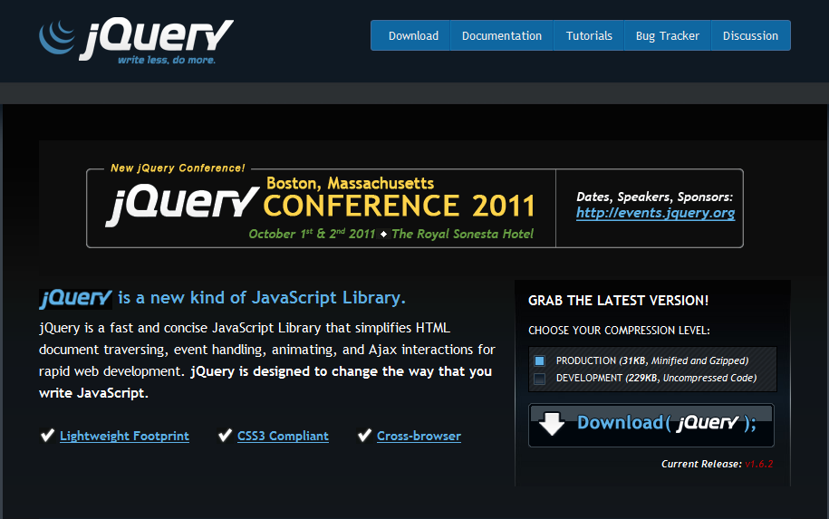
jquery.com (Official Website for jQuery)
Notes:
Add the notes here.
Additional notes for instructor

Slide 7
Using jQuery
  <html>
  <head>
  <title>Test jQuery</title>
  <script type="text/javascript" src="jquery-1.6.4.js"></script>
  <script type="text/javascript">
    $(document).ready(function(){
    alert('Hi'); });
  </script>
  </head>
  <body>
  jQuery Enabled
  </body>
  </html>
Notes:
Add the notes here.
Additional notes for instructor

Slide 8
Demo
Test-jQuery.html
Notes:
Add the notes here.
Additional notes for instructor

Slide 9
jQuery code assistance
VS 2008 / 2010 provides jQuery Intellisense
  http://www.appendto.com/community/jquery-vsdoc
  Place jQuery-vsdoc.js file into the same path as the jquery.js file
  http://weblogs.asp.net/scottgu/archive/2008/11/21/jquery-intellisense-in-vs-2008.aspx
Other IDE’s
  Eclipse(with plug-in) - http://www.eclipse.org/
  Aptana Studio - http://www.aptana.com/
Notes:
Add the notes here.
Additional notes for instructor

Slide 10
Content Delivery Network(CDN)
Script can be also accessible from
  Microsoft - http://ajax.aspnetcdn.com/ajax/jQuery/jquery-1.6.2.min.js
  jQuery - http://code.jquery.com/jquery-1.6.2.min.js
  Google - http://ajax.googleapis.com/ajax/libs/jquery/1.6.2/jquery.min.js
A CDN short for Content Delivery Network distributes static content across servers in various, diverse physical locations. When a user’s browser resolves the URL for these files, their download will automatically target the closest available server in the network.
If jQuery is hosted locally then users must download it at least once. Each of your users probably already has dozens of identical copies of jQuery in their browser’s cache, but those copies of jQuery are ignored when they visit your site. Even if someone visits hundreds of sites using the same CDN hosted version of jQuery, they will only need download it once!
Notes:
Add the notes here.
Additional notes for instructor

Slide 11
noConflict method
Many JavaScript libraries use $ as a function or variable name, just as jQuery does.
In jQuery’s case, $ is just an alias for jQuery, so all functionality is available without using $. If we need to use another JavaScript library alongside jQuery, we can return control of $ back to the other library with a call to $.noConflict
  <script type="text/javascript" src="other_lib.js"></script>
  <script type="text/javascript" src="jquery.js"></script>
  <script type="text/javascript">
  $.noConflict();
  //Code that uses other libraries $ can follow here.
  </script>
Notes:
Add the notes here.
Additional notes for instructor

Slide 12
Lab
1.1: Creating jQuery Page
1.2: Accessing jQuery Script from CDN
Notes:
Add the notes here.
Additional notes for instructor

Slide 13
Summary
jQuery is a cross browser java script library
Available at http://www.jquery.com
Provide a robust way to manipulate DOM elements
The ready() function detects when the DOM hierarchy is loaded
Notes:
Add the notes here.
Additional notes for instructor

Slide 14
Review Question
Which sign does jQuery use as a shortcut for jQuery?
  $ Sign
  % Sign
  # Sign
  ? Sign
Which jQuery function is used to prevent code from running, before the document is finished loading?
  $(document).load()
  $(document).ready()
  $(body).onload()
Notes:
Add the notes here.
Answers for the Review Questions:

